Slide 1



Know Your Brew!
Saifee, Courtney, Sarah and Aparna

Slide 2

Outline
Business Objectives (1-2 min)
Data Mining techniques (1-2 min)
Coding Approach (1 min)
Data/ App architecture (1-2 min)
Final Interactive Visualizations (2-4 min)
- Live Demo
- Screenshots and annotations
Appendix
Future Works (30 sec)

Slide 3

Project Overview
Our project goal is to start a coffee business and set up a website for that purpose.
Key areas:
Worldwide trend in Coffee production, export
Using YELP API to find coffee places nearby and allow users to sort by rating, review count and distance. Also plotting the fetched places on the map and providing yelp page link for more details.
Using Twitter API to find latest tweets related to coffee
Scrapping website to get latest coffee news
Displaying coffee trends through images

Slide 4

Data Sources and Analysis Approach
ICO Historical Data on the Global Coffee Trade for the year of 2016 and 2017

Slide 5

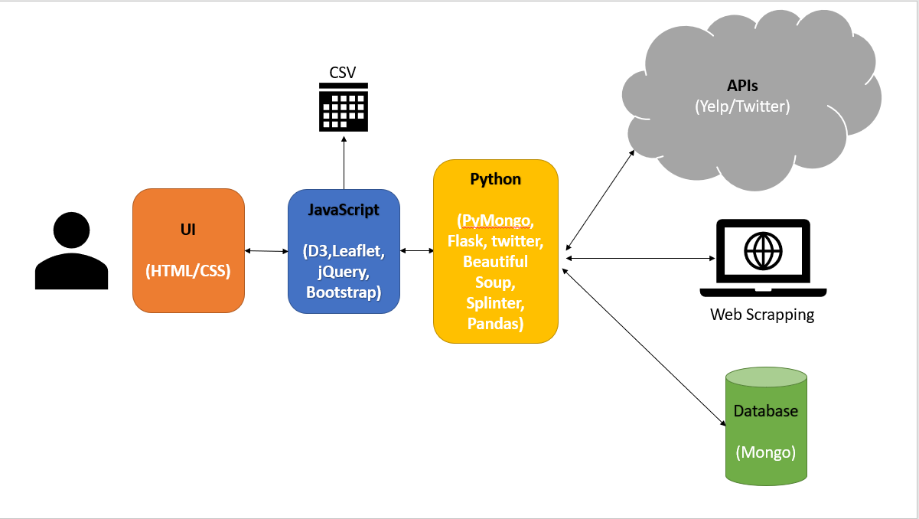
Data Flow & Architecture

Slide 6
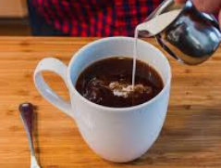
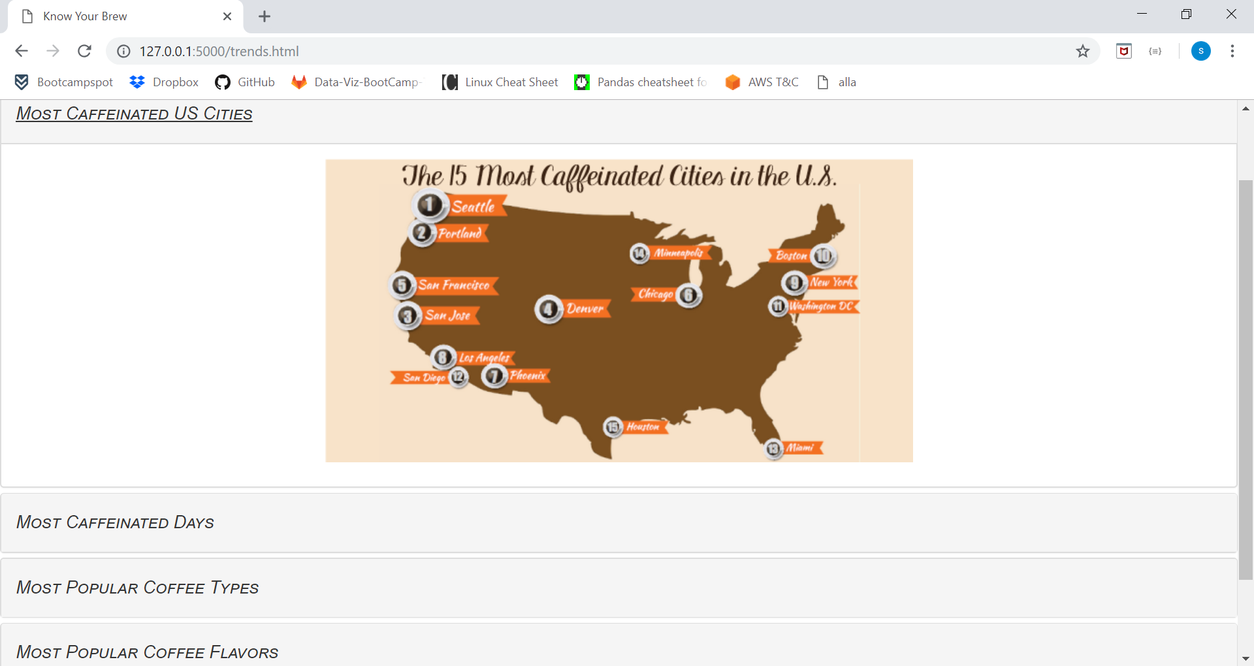
Coffee Trends

Slide 7

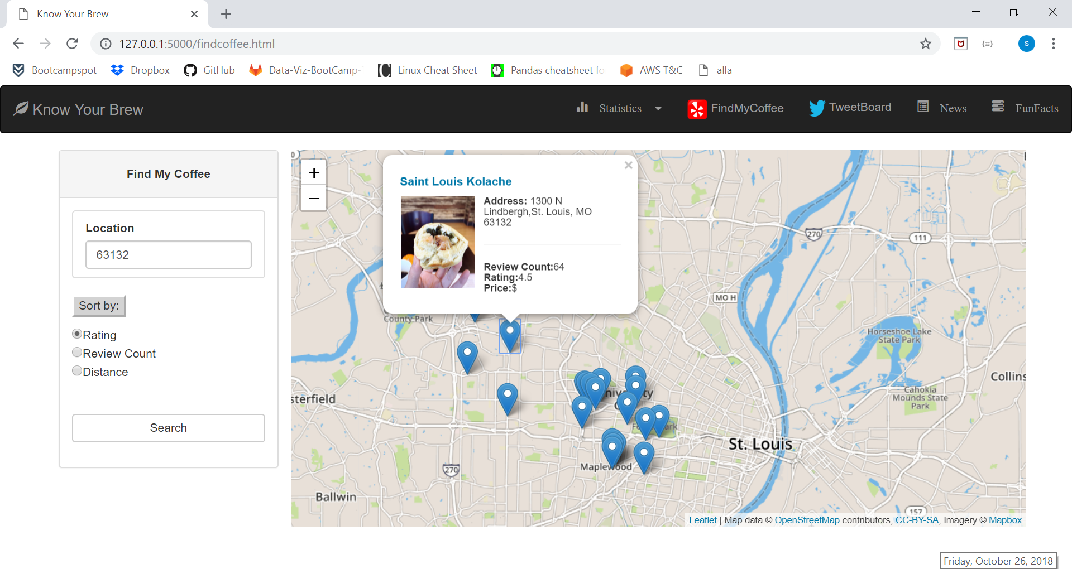
FindMyCoffee (Yelp API)

Slide 8
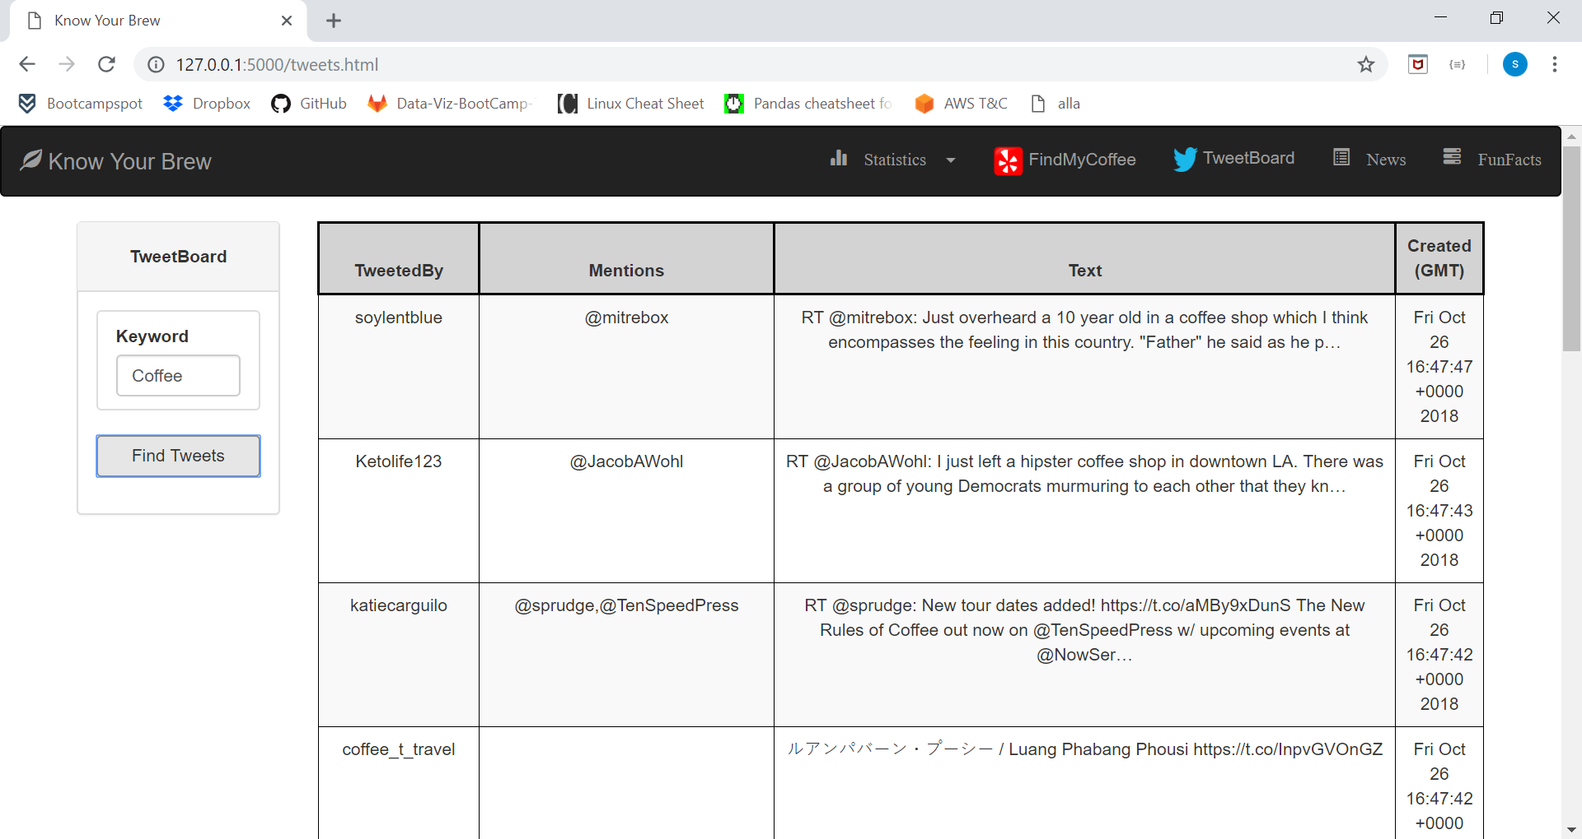
TweetBoard (Twitter API)

Slide 9
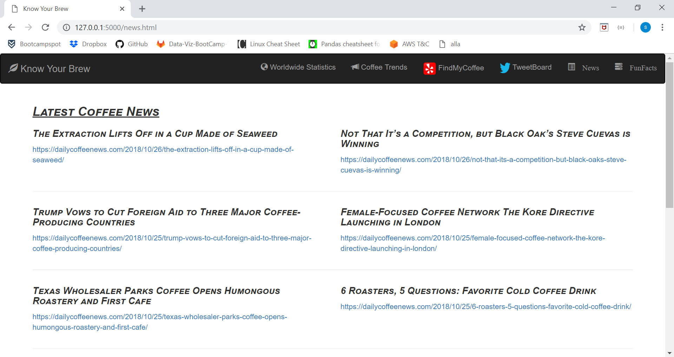
Coffee News

Slide 10

Data handling challenges
{
"type": "Feature",
"geometry": {
"type": "Point",
"coordinates": [ -74.297333,4.570868 ]
},
"properties": {
"rank":3,
"country":"Colombia",
"production":14634,
"export":12898
}
},
{
"rank":3,
"country":"Colombia",
"coordinates": [ 4.570868,-74.297333 ],
"production":14634,
"export":12898,
"radSize":20
},

Slide 11

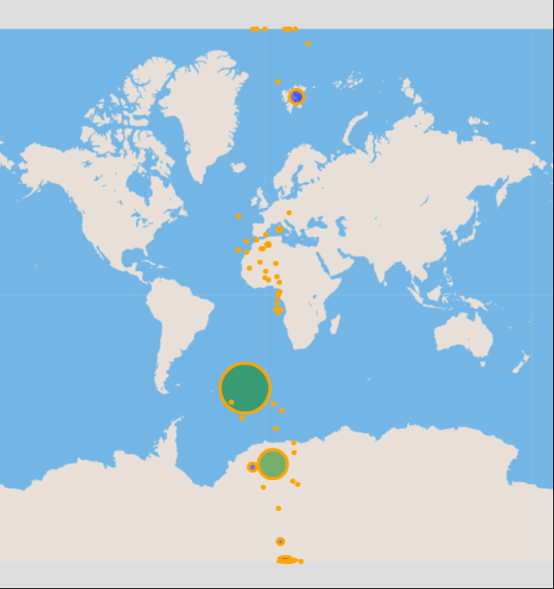
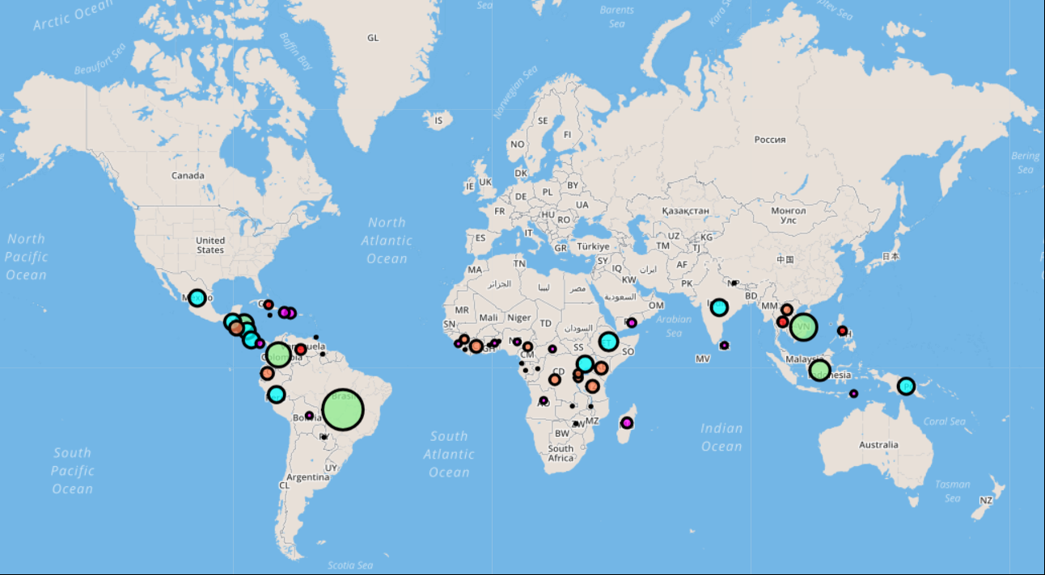
Difficulties

Slide 12
Difficulties
Yelp API:
We were planning to tap the Yelp API through Javascript directly and faced authorization issues. However, after lots of R&D and with Rob’s help ☺, we got to know that Yelp does not allow clients to invoke the APIs through a frontend platform like Javascript. We then pivoted to call the API through backend (Python)
Reference: https://github.com/Yelp/yelp-fusion/issues/386
Web Page Navigations:
As the entire application is hosted on flask, we could not navigate between different html pages just by providing <href> attribute to the navigation items. We identified later that each <href> would need to be added as an app route in the python file which would then render that html.

Slide 13

Resources
https://developers.google.com/public-data/docs/canonical/countries_csv (latlon)
http://www.convertcsv.com/csv-to-geojson.htm (csv converter)
https://www.kaggle.com/sbajew/icos-crop-data (ICO-cleaned data)
http://www.ico.org/new_historical.asp
http://www.ncausa.org/about-coffee/coffee-around-the-world
http://www.most-expensive.coffee/
https://financesonline.com/top-10-most-expensive-coffee-in-the-world-luwak-coffee-is-not-the-no-1/
https://www.worldatlas.com/articles/top-coffee-producing-countries.html
https://www.yelp.com/developers/documentation/v3/business_search
https://developer.twitter.com/en/docs/tweets/search/api-reference/get-search-tweets.html
https://dailycoffeenews.com

Slide 14



